Slide 1
Architecture Analysis and Improvement
Faculty Advisor - Jia Zhang Team - 9
[18-653] Software Architecture and Design, Spring 2016

Slide 2
Roadmap
Introduction
Motivation
System Design
Design Pattern
Conclusions and future work

Slide 3
Introduction
Software architecture has become increasingly important in the software engineering community.
Software architecture deals with the high-level building blocks that represent an underlying software system.
Analyze existing legacy architecture, and try to improve it by using some useful design patterns to make the whole system more reusable, extensible and maintainable.

Slide 4
Motivation
Provide scientists a platform to
Share ideas and interact with peers
Focus on workflow part of scientific researches
Goals
Easier contribution to scientific methods
Build communities
Reduce time-to-experiment
Share expertise
Share experiences
Avoid reinvention

Slide 5
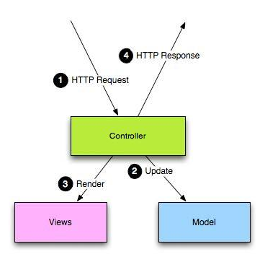
System Structure
Play framework (MVC)
Front-end
View
Bootstrap
jQuery
Controller
RESTful APIs
Back-end
Controller
Data operation support for Model
Model
MySQL database

Slide 6
Design Pattern
Factory
Flyweight
Façade
Strategy
Builder
Visitor
Template
Command

Slide 7
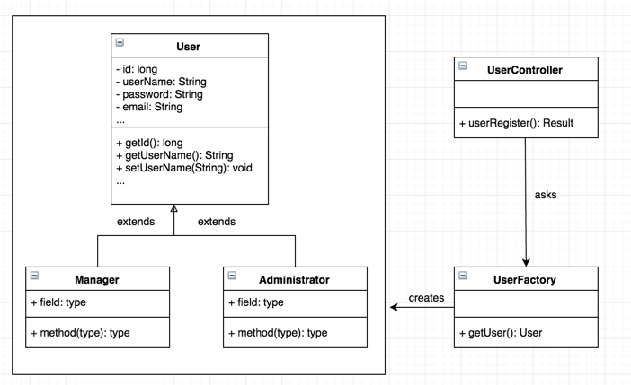
Factory
Definition:
Create object without exposing the creation logic to the client
with a common interface.
Pros:
Act as a superclass when creating objects.
Cons:
Sometimes unnecessary when creating logic is simple.
Where to use in CMDA:
Register/create user with different types. (user, manager, admin)

Slide 8
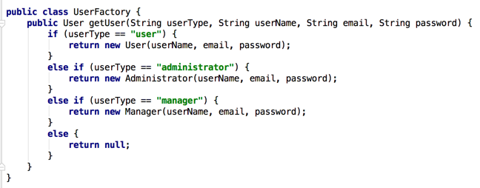
Factory
How:
- Define a UserFactory
- Create an user object based on specific user type.

Slide 9
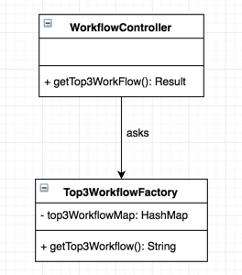
Flyweight
Definition:
Flyweight pattern is primarily used to reduce the number of objects created.
Pros:
Decrease memory footprint and increase performance
by reusing already existing similar objects when creating objects.
Cons:
Flyweight is not preferred when objects being created have no similarity.
Where to use in CMDA:
Create top-3 workflow object, quite stable.

Slide 10
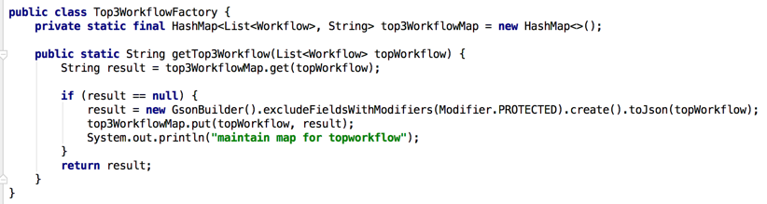

Flyweight
How:
- Define a Top3WorkflowFactory with a HashMap.
- Get String result by reusing the similar objects stored in the HashMap, instead of creating from scratch every time.

Slide 11
Façade
Definition:
Hides the complexity of the system and provides an interface to the client.
Pros:
Hides complexity, clearer code, better maintainability and extensibility.
Cons:
Can have too many APIs if there are lots of underlying classes.
Where to use in CMDA:
Provides a single simplified interface for all Controllers.

Slide 12
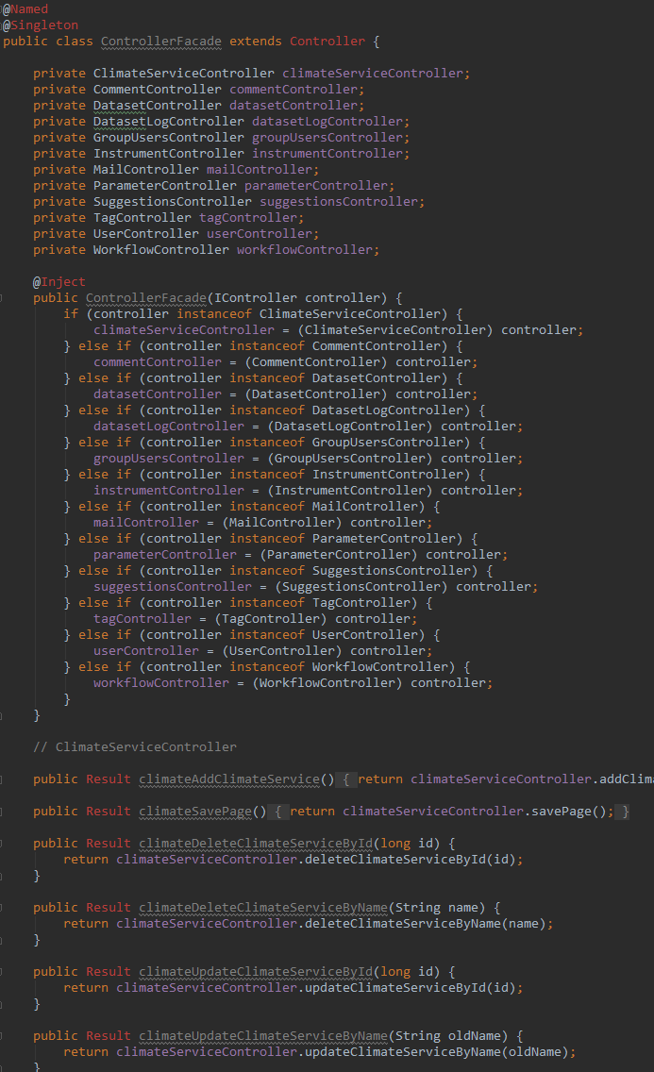
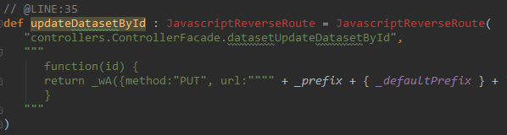
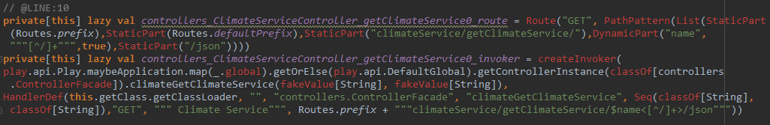
Façade
Provides a single simplified interface for all Controllers
- Hides complexity
- Clearer code
- Better maintainability and extensibility
- Difficult to apply the new pattern

Slide 13
Strategy
Definition:
A class behavior or its algorithm can be change at run time.
Pros:
One API multiple functionalities, better customizability and flexibility
Cons:
Sometimes unnecessary when we also need to call other APIs
Where to use in CMDA:
Method behavior (toString, getId) can/need to be changed at run time in Model classes

Slide 14
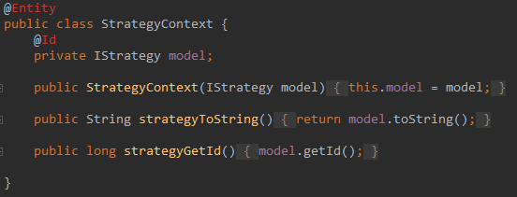
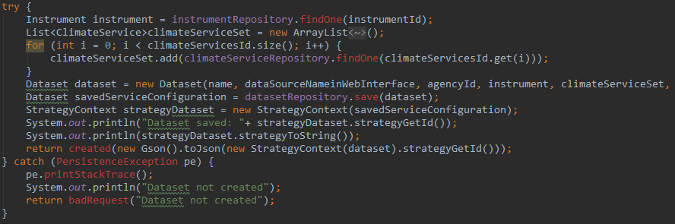
Strategy
Method behavior can be changed at run time in Model classes
- Using one Strategy class instead of calling different methods from different classes
- Better customizability, flexibility, maintainability, and reusability
- Can only be used for methods in common, have to use original classes for other methods

Slide 15
Builder
Definition:
Builder design pattern is to separate the construction of a complex object from its representation
Pros:
Making the same construction process create different representations
Provides control over steps of construction process
Allows you to vary a product’s internal representation
Cons:
Builder is not preferred when the construction of the object is simple
Where to use in CMDA:
Create an nested static class WorkFlowBuilder in WorkFlow Class

Slide 16
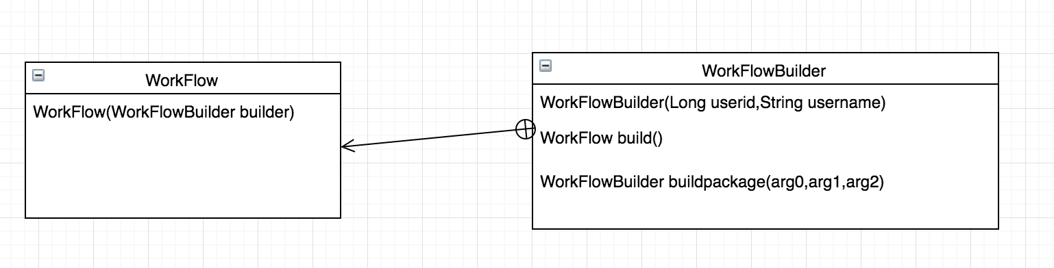
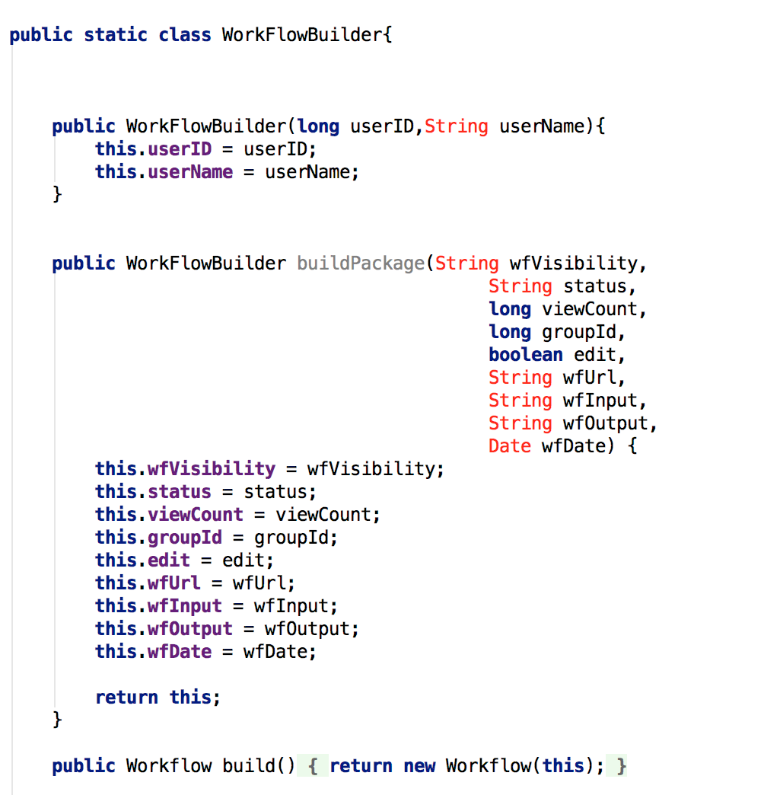
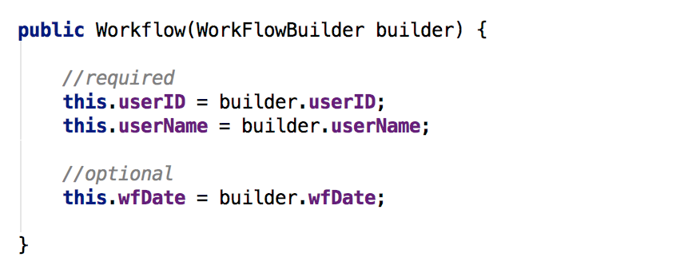
Builder
How:

Slide 17
Visitor
Definition:
Represent an operation to be performed on elements of an object structure. Visitor lets you define a new operation without changing the classes of the elements on which it operates
Pros:
The nature of the Visitor makes it an ideal pattern to visit the special part of an object without interfere with the whole part
Cons:
Visitor is not preferred when object is quite simple has no composite parts
Where to use in CMDA:
Create an interface ServiceVisitor for ServiceEntry class

Slide 18
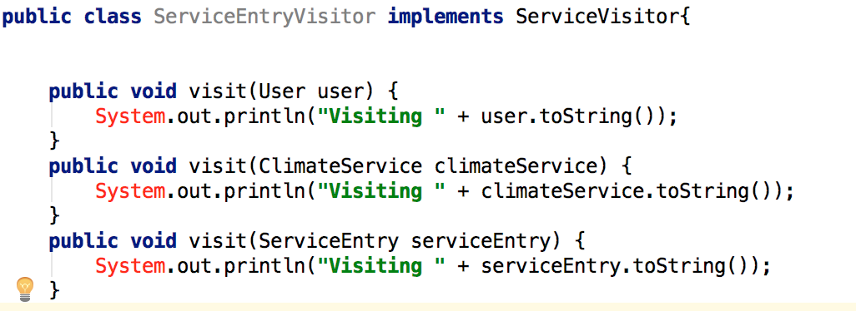
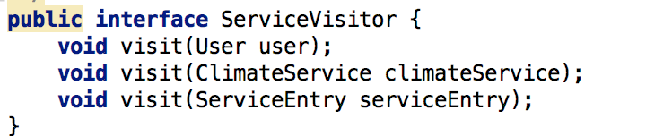
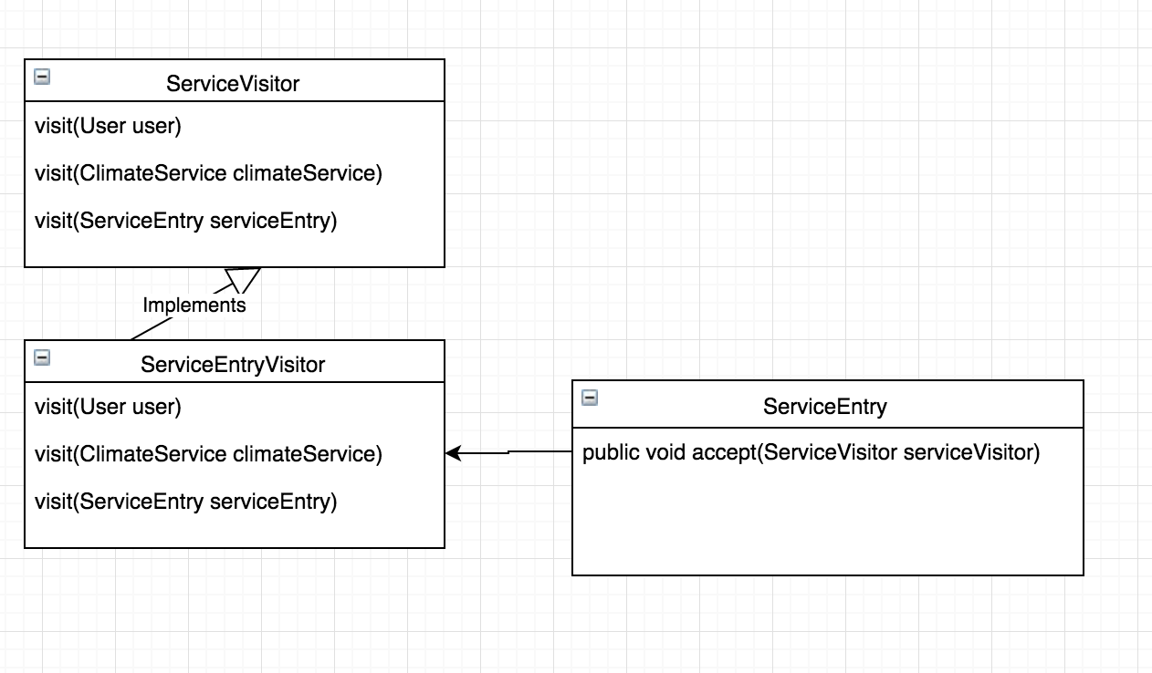
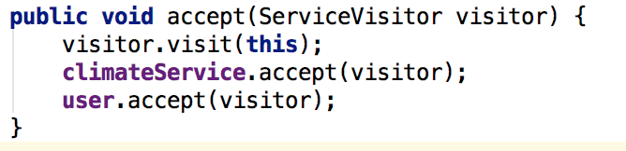
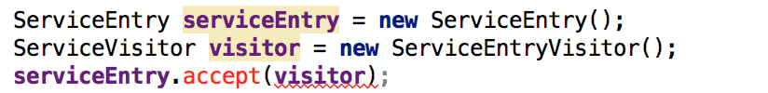
Visitor
How:

Slide 19
Template
Definition:
A behavioral design pattern that defines the program skeleton of an algorithm in a method, called template method, which defers some steps to subclasses.
Pros:
Avoid duplication in the code: the general workflow structure is implemented once in the abstract class's algorithm.
Cons:
Inheritance bring strong coupling relation between classes
Where to use in CMDA:
MailController and GroupUsersController extends Store

Slide 20
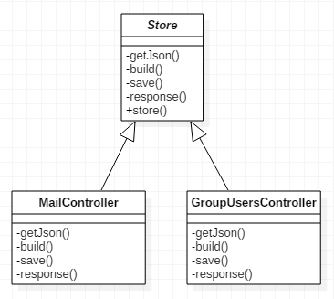
Template

Slide 21
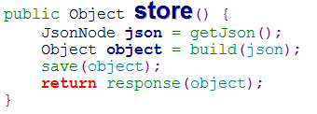
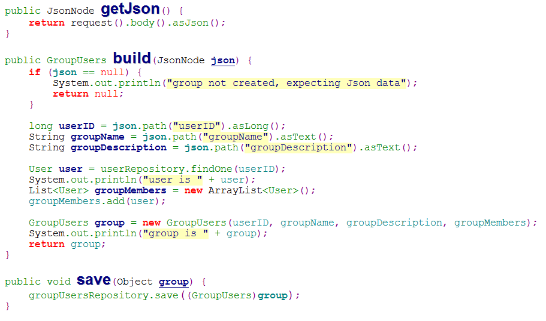
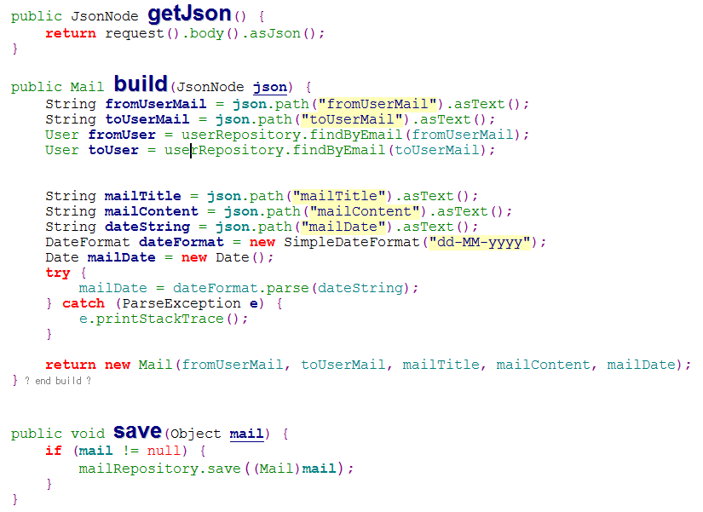
Template
How:

Slide 22
Command
Definition:
A behavioral design pattern in which an object is used to encapsulate all information needed to perform an action or trigger an event at a later time. This information includes the object that owns the method and values for the method parameters.
Pros:
Make it easier to construct general components that need to delegate, sequence or execute method calls at a time of their choosing without the need to know the class of the method or the method parameters.
Cons:
Command Pattern is not preferred when delegation is not required
Where to use in CMDA:
HTTP Helper

Slide 23
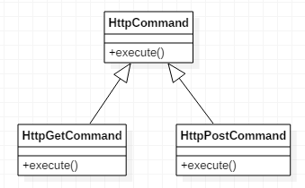
Command

Slide 24
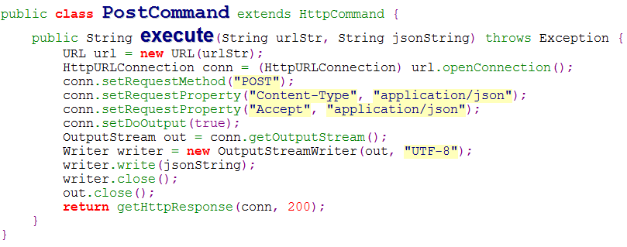
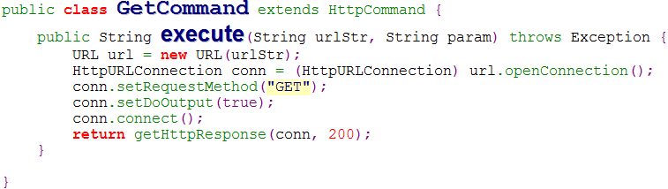
Command
How:

Slide 25
Conclusion
Benefits:
Provide a stronger reusability, extensibility, and maintainability for the system, and make it well-structured by applying some useful design patterns.
Constraints:
Increased effort to apply
More classes and interfaces to maintain
Poor performance due to indirection
Suggestion:
Try to apply more useful design patterns after carefully
analyzing their tradeoff.

Slide 26

Questions?

